Slide 1

Where Immersive AV Experiences Begin

Slide 2
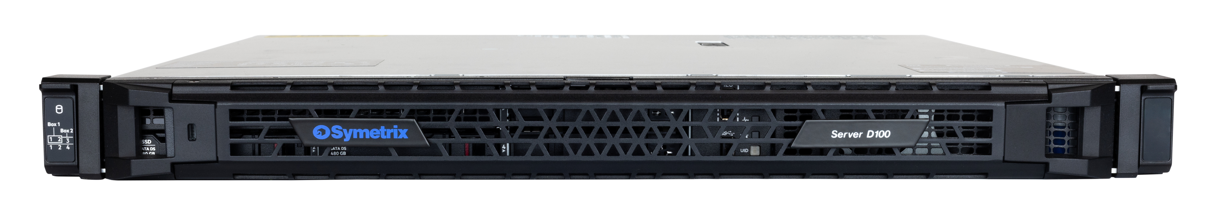
D100 IP DSP Server
High performance, enterprise level, large scale centralized processing to manage and control high counts of channels and networked devices.
________
Centralized processing of large quantities of IP endpoints.
________
Unified approach to monitoring and maintaining equipment.
________
Server scalability with three on demand field upgrades for more channels.
________
Enterprise COTS rack mountable server platform.
________
Extensive standard control options.

Slide 3





D100 IP DSP Server
HP Enterprise Server Platform
D100 leverages an HP Enterprise server platform that incorporates that latest high performance multi-core processors,
Unified Audio Processing
D100 offers Dante channels, acoustic echo cancellation (AEC) channels, media playback channels, media record channels, and premium audio. processing in a single unified system.
Centralized Processing
D100 provides centralized processing of large quantities of IP endpoints within a single component.
Upgrades
D100 is a scalable server with three field upgrades to increase the Dante channel count, the internal media playback channel count, and the AEC. channel count.
Notes:
The Symetrix D100 DSP Server leverages an HP Enterprise server platform that incorporates the latest high performance multi-core processors. D100 is a rack mountable unit with dedicated internal SSD media storage, multiple network ports, and dual redundant, hot swapable power supplies.
D100 is purpose-built for large scale systems such as campuses, transportation hubs, museums, business centers, sports and performing arts venues, and more.
D100 provides centralized processing of large quantities of IP endpoints including microphones, amplifiers, computers, remote controls, and control screens all within a single component to greatly simplify designing and deploying solutions that communicate and interact across multiple rooms, floors, buildings, or campuses. Managers of such systems benefit from a unified approach to monitoring and maintaining the equipment used in their media environments.
On-demand software upgrades cost-effectively extend system performance by expanding channel counts and media management capacity. D100 is future ready when system needs change over time.

Slide 4
D100 IP DSP Server
Key Benefits
Cost-effective, high-performance solution delivering
top-superior audio quality.
Seamlessly integrates every audio source and destination into designs.
Effective and efficient installation and programming for larger audio/video/control system requirements.
Expansive Dante channel count offers flexibility and scalability for audio control and network integration.
High AEC channel count for use in conference rooms or deployment across multiple conference rooms.
Integrated record and playback of prerecorded messages on multiple channels.
Extensive digital signal processing capabilities for large quantities of different devices.
Firmware upgrades in the field to increase various channel counts.
Fast and easy configuration and control with Symetrix Composer software.
Notes:
Cost-effective, high-performance solution that streamlines installations, reduces hardware complexity, and maximizes project efficiency while delivering top-superior audio quality.
Seamlessly integration of every audio source and destination into designs enabling unique possibilities for any sort of media space.
Effective and efficient installation and programming for larger audio/video/ control system requirements.
Expansive Dante channel count offers unparalleled flexibility and scalability for audio control and network integration even in the most demanding and complex environments.
High AEC channel count for integration into larger conference rooms or deployment across multiple conference rooms.
Integrated record and playback of prerecorded messages on multiple channels for announcements and alerts crucial to public facilities.
Extensive digital signal processing capabilities include compression, EQ, and matrix mixing for large quantities of different devices.
Firmware upgrades in the field to increase various channel counts contribute to making the system scalable and cost effective.
Fast and easy configuration and control with Composer software.

Slide 5
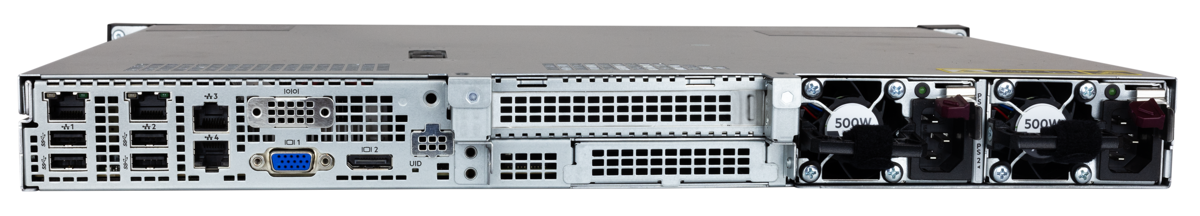
D100 DSP Server
2 Dante Ports
1 Control Port
1 HPe ILO Port
Dedicated 500 GB SSD Media Drive
Dual Redundant Hot Swapable Power Supplies
Rack Kit Included
Up to 384 x 384 Dante channels
Up to 96 AEC channels
Up to 128 Internal Media Player Channels
Notes:
Field licensable increased Dante channels
Field licensable increased AEC channels
Field licensable increased Internal Media Playback channels
Up to 4x processing as compared to Symetrix Radius NX DSP

Slide 6
D100 DSP Server
Key Features
256 × 256 Dante I/O channels,
option to add 128 × 128 Dante I/O channel
64 channels of acoustic echo cancellation (AEC), option to add 32 AEC channels
32 media playback channels,
option to add 32 or 96 media playback channels
8 media record channels
Extensive control options via Symetrix SymVue Windows interfaces, T-Series touchscreens, Control Server, W-Series remotes, ARC-WEB interfaces, and TCP/UDP standard
Lua scripting support included
Third-party control via Intelligent Modules included
DSP and select third-party Dante device configuration with Composer application
Expanded count of Intelligent Modules simultaneously active
ILO port and SNMP support
ARC-Web support
Secure boot- Boots only from signed drive. Hardware Locking- Blocks moving of drive. Secure TPM Module- Holds keys in dedicated secure hardware unique to each D100

Slide 7
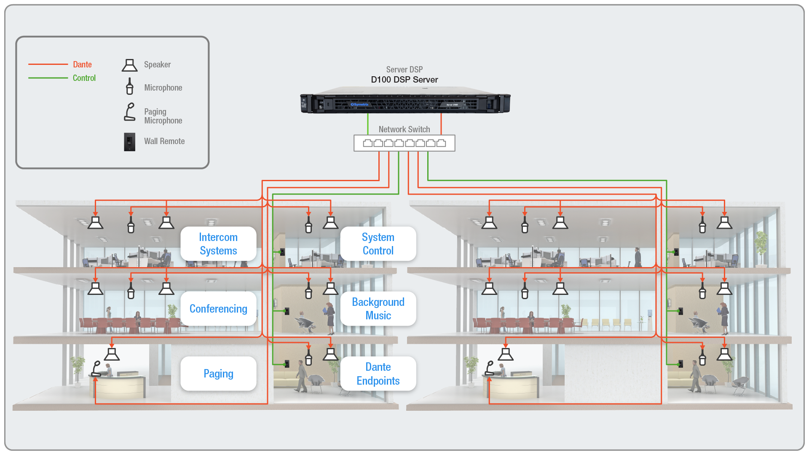
D100 DSP Server
Corporate
Facilities spanning multiple floors and/or buildings require local I/O and control for all conference rooms.
D100 is invaluable in the case of emergency alerts and notifications with support for high channel counts.
Notes:
Within a large-scale corporate facility, it's common for a single company to span multiple floors and/or buildings. Wherever they are located, each conference room has a requirement for both local I/O and room control that D100 makes easy to administer. To enhance operations, the use of low-latency audio routing between adjacent rooms is also desirable. Additionally, the high channel counts of D100 prove invaluable in the case of emergency alerts and notifications throughout offices, warehouses, and manufacturing facilities.

Slide 8
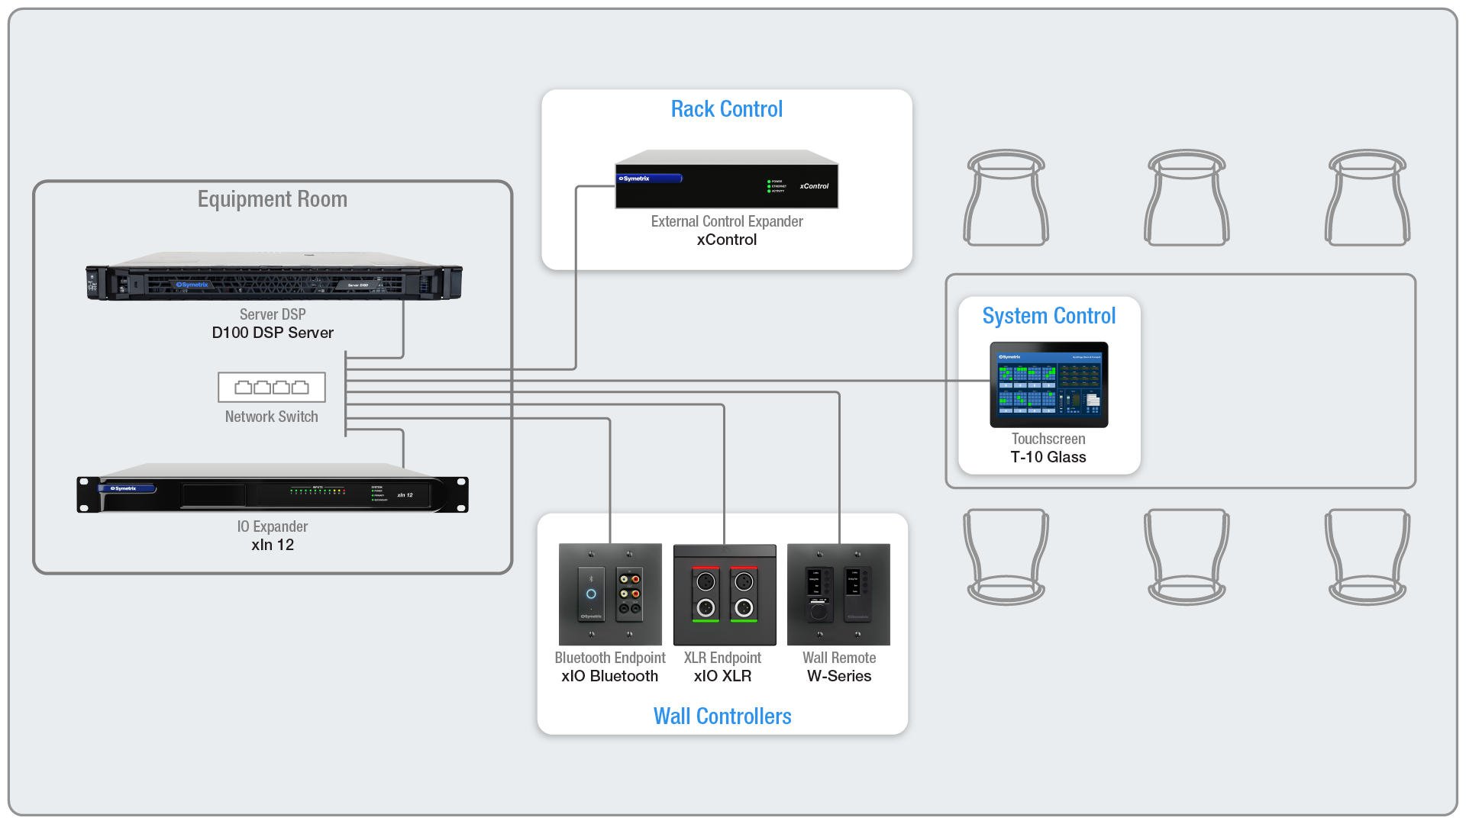
D100 DSP Server
Business
Conferencing often requires AEC (acoustic echo cancelation) to communicate with people in external locations. D100 can expand as conference rooms need to scale up or more conference rooms are added.
Notes:
Conference rooms are one of the biggest users of AEC (acoustic echo cancelation) because of their need to communicate with people outside of their environment. As conference rooms need to scale up or more conference rooms are added, processors must be increased as well. Rather than having to program and maintain multiple systems all doing the same thing, D100 can expand to retain a centralized system implementation that can easily be administered.

Slide 9
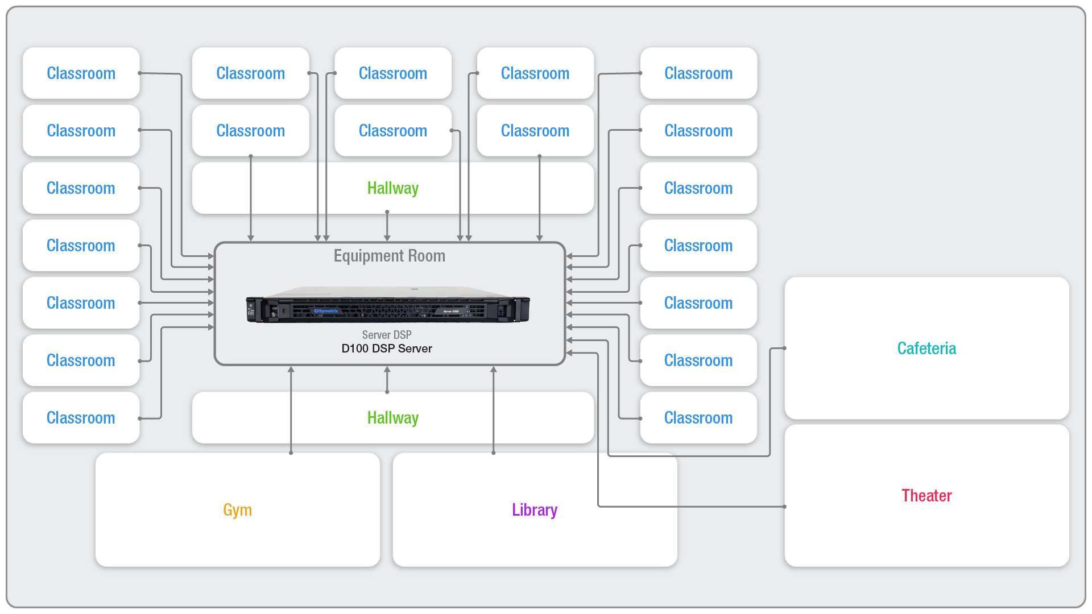
D100 DSP Server
Education
Campuses need to process, mix, and redistribute many audio channels to a variety of locations.
D100 satisfies the requirements of administration/IT/security centers.
Notes:
Campuses need to process, mix, and redistribute many audio channels to a variety of locations for uses such as announcements, alerts, and playback.
D100 satisfies the requirements of administration/IT/security centers that need to monitor audio feeds, and at the same time communicate back to each individual connected location.

Slide 10
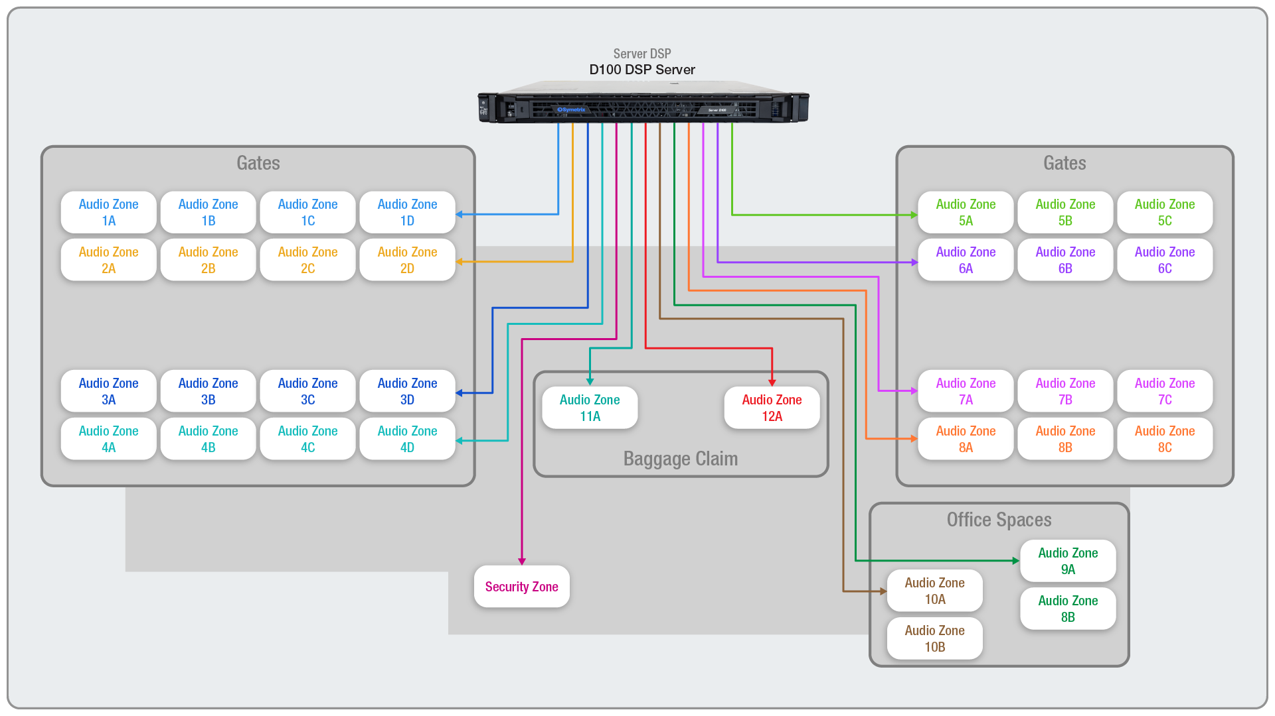
D100 DSP Server
Venues
Performing arts, transportation, and amusement parks all have specialized distribution needs for audio routing and interactive controls. D100 distributed control of endpoints solves managing large control signaling and audio distribution matrices.
Notes:
Airport, train, and bus terminals along with stadiums, exhibition halls, and amusement parks all have specialized audio and control distribution needs. Audio routing across the facility is not only needed for public announcements, playback, and safety needs but also for interactive control requirements for triggering actions and devices across facilities. The D100 large channel count DSP server with distributed control endpoints solves the challenge of managing large matrices of control signaling and audio distribution.

Slide 11
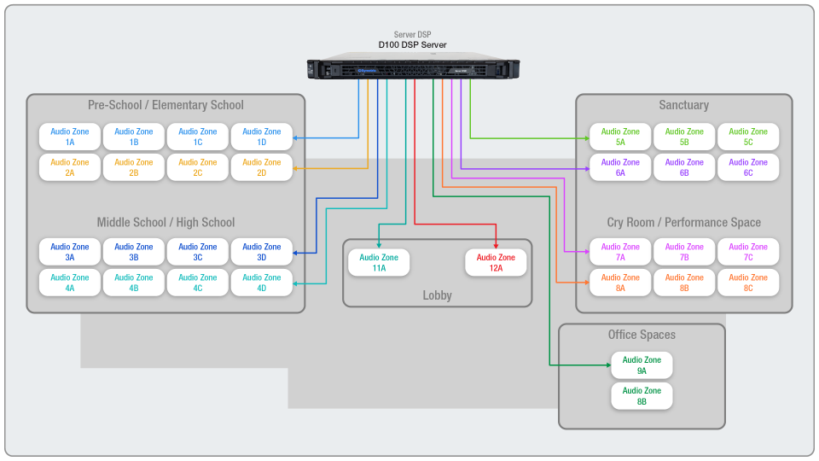
D100 DSP Server
Worship
All synagogues, mosques, and churches need clear delivery of messaging to every listener no matter where they are located. D100 is optimized for sound processing and dynamic audio control across spaces, rooms, and buildings.. .

Slide 12
Where Immersive Experiences Begin
www.symetrix.co

